Slide 1
Rosenzweig’s Instability
Tianyang Hu
Graduate Research Assistant
thu98@gatech.edu
Álvaro Romero Calvo
Assistant Professor
alvaro.romerocalvo@gatech.edu
11/28/2023

Slide 2
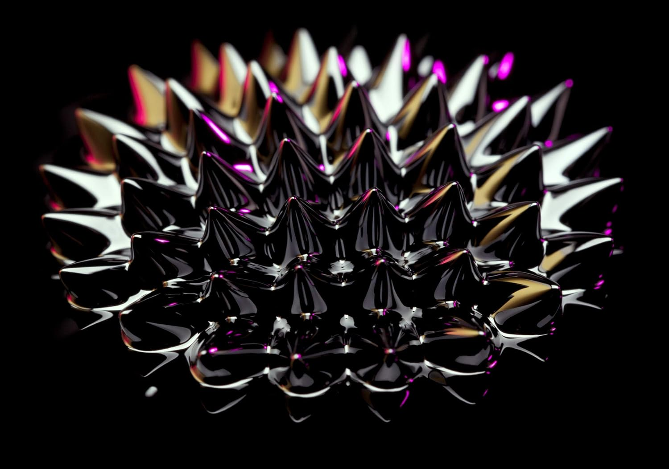
Concept
Rosenzweig's instability, also known as normal-field instability, is a phenomenon observed in ferrofluids. When a magnetic field is applied perpendicular to the surface of a ferrofluid, the fluid initially responds uniformly. As the magnetic field’s strength increases, the ferrofluid’s surface becomes unstable. This leads to the formation of a regular pattern of peaks and troughs.
The instability is a result of the competition between various forces. Magnetic forces try to draw the fluid into regions with the strongest magnetic field (usually where the field lines are densest), while surface tension and gravity resist this deformation.

Slide 3


Magnets and Ferrofluid for Simulation
Magnets: B888-N52 (Block)
Ferrofluid: EMG water-based series

Slide 4
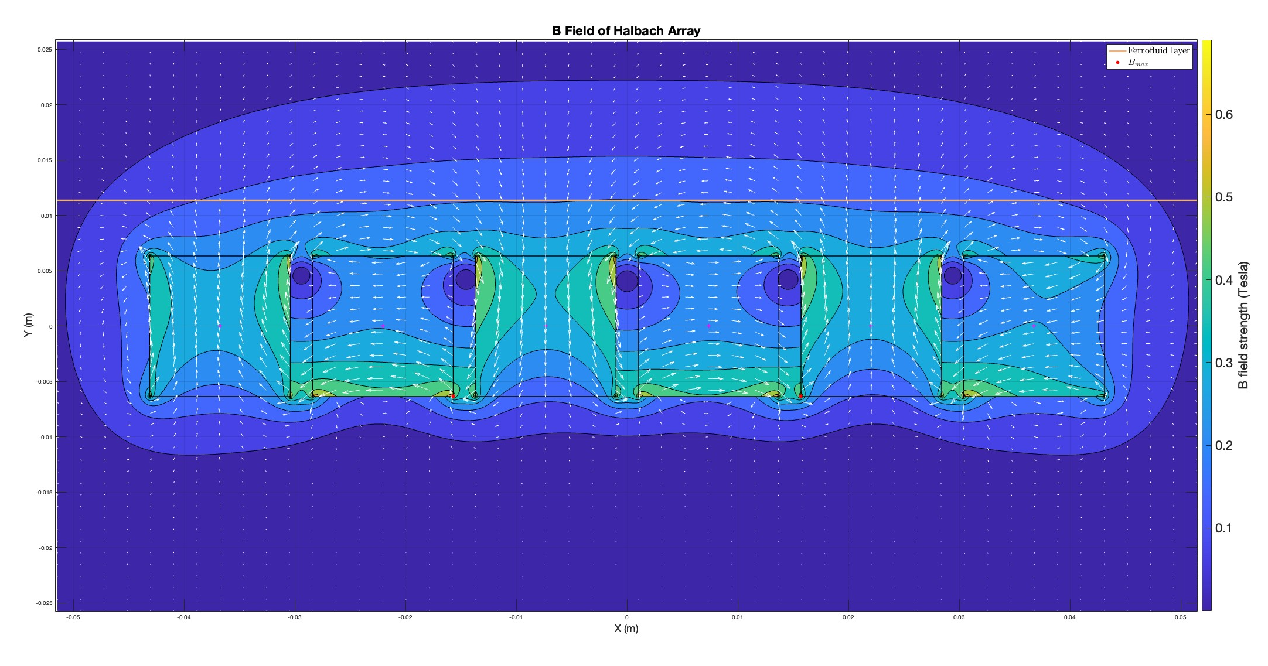
Simulation Scheme

Slide 5
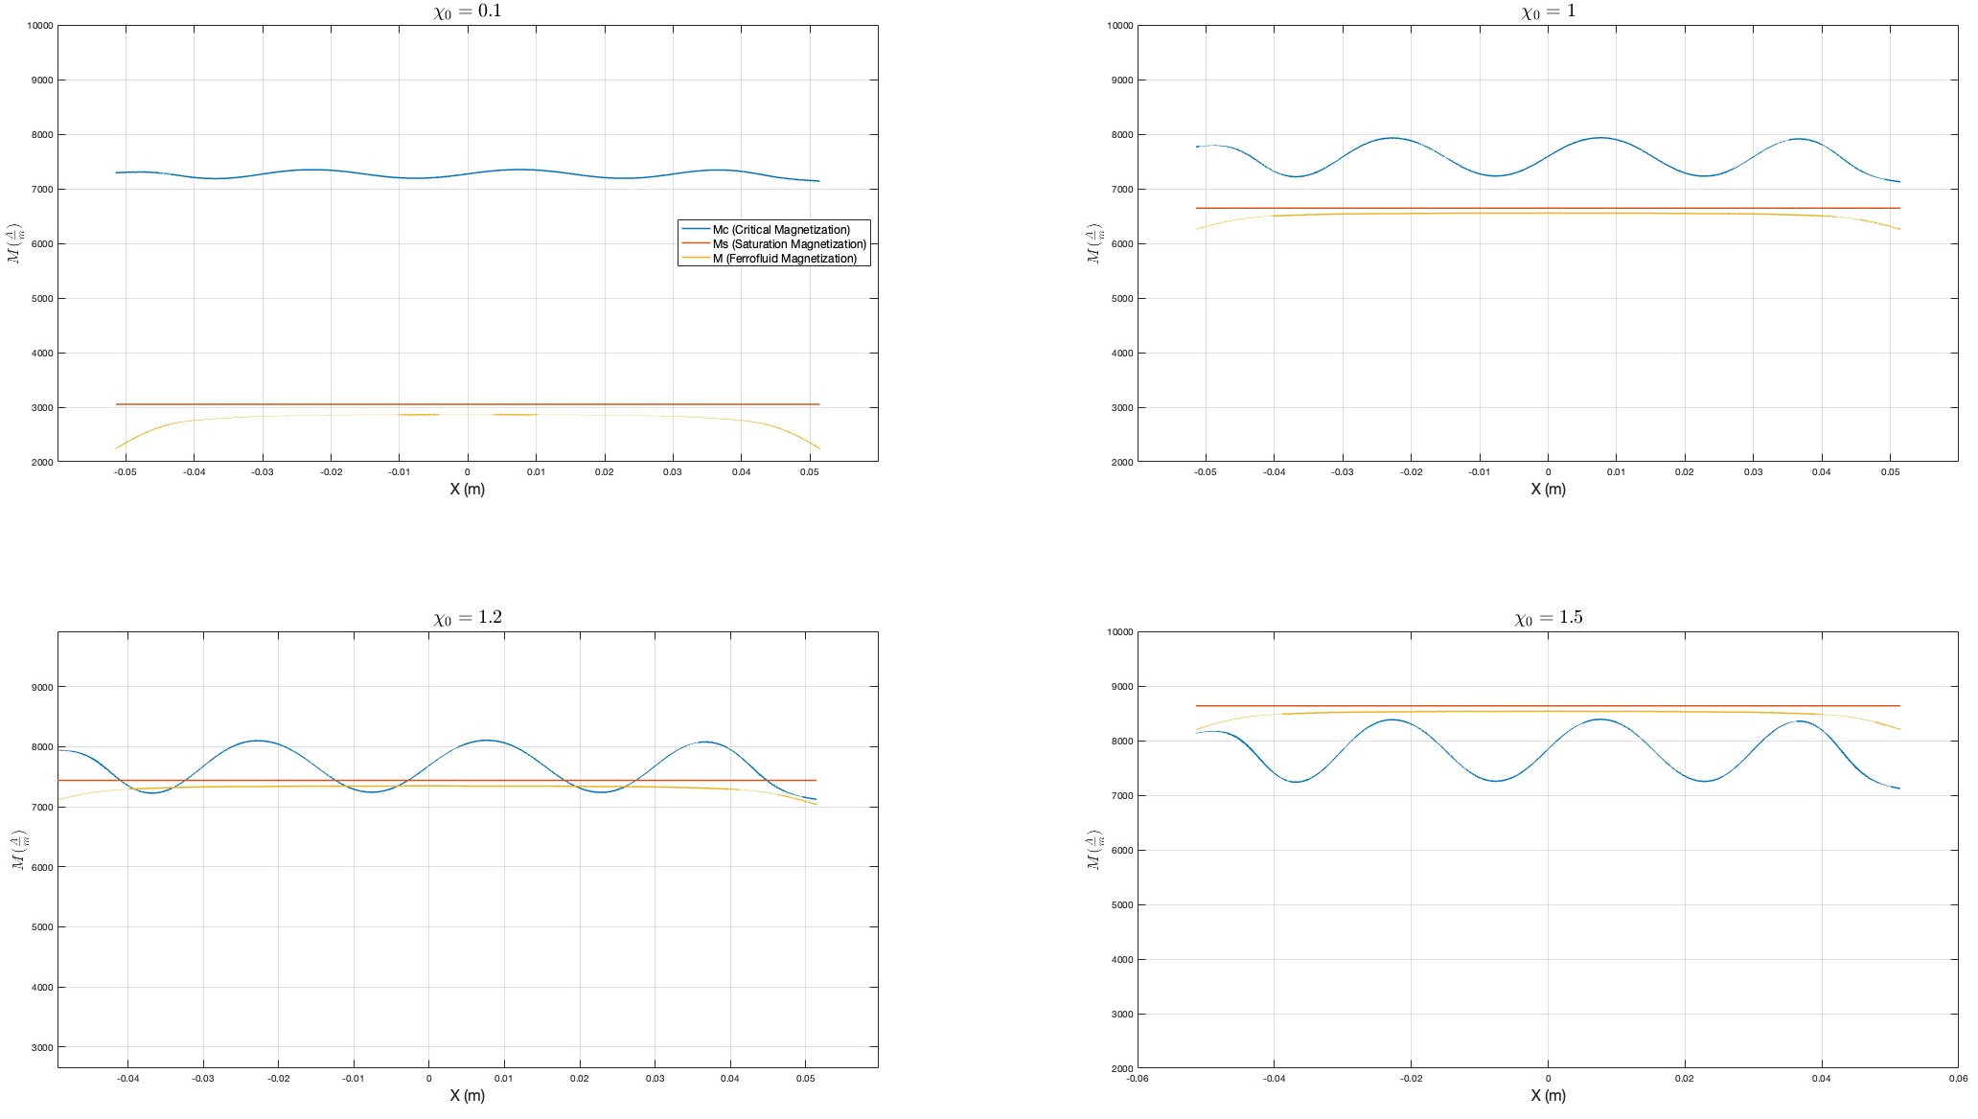
Critical Magnetic Field Strength
There's a critical magnetic field strength at which this instability occurs. Below this threshold, the ferrofluid surface remains flat.

Slide 6


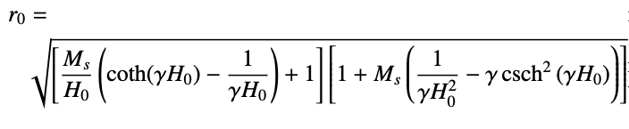


MATH equations
Critical Magnetization $M_{Crit}$ for Oblique External Field for nonlinear media.

Slide 7
Thank You

